Slide 1

LPG leakage detector with buzzer indication using Microcontroller
SCHOOL OF COMPUTER SCIENCE AND ENGINEERING M.C.A. (MASTER IN COMPUTER APPLICATION)
Team Members
Nikhil Teotia 21MCA1024
Joy Bhattacharjee 21MCA1015
Lakshay 21MCA1056
Nikhil Saraogi 21MCA1080
Alin Paul 21MCA1054
Vinayak Singh 21MCA1064
Under the Guidance of
Dr. VERGIN RAJA SAROBIN M

Slide 2
Introduction
Project Aim: To monitor LPG and give overheat indication with the help of Buzzer. LCD interface to message.
Main parts of project: LPG sensor, Comparator, Microcontroller, Buzzer, LCD display, Voltage regulator

Slide 3
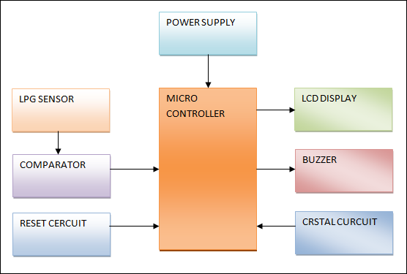
Block Diagram

Slide 4
Component List
AT89s51 7805 LM358 BC547 TRANSFORMER CAPACITOR DIODES(1N4007) RESISTORS LPG Sensor | LCD Display LM35 CRYSTAL LED Buzzer POT LCD CONNECTOR IC SOCKETS CONNECTORS

Slide 5
Block diagram Description
1) LPG sensor :- LPG sensor is the sensor that measures the amount of gas in the surrounding environment. It gives voltage output. The output is in the form of analog voltage. This output varies from 0 to 5 volts.
2) Comparator: The output voltage from sensor and voltage divider is given to the comparator. This comparator compares the voltage from sensor and gives output to the microcontroller.

Slide 6
3) MICRO-CONTROLLER (89s51):- It is the major part and heart of system. It controls all the inputs & the controlling action to be taken at the output. Microcontroller used here is the AT89S51.
4) Liquid Crystal Display :-It is an Alphanumeric Display. Used for displaying various messages. We have used 16 x 2 Alphanumeric Display.
5) Buzzer: We have used a piezoelectric buzzer in our project. It is used for alert indication. The buzzer will be turned on when sensor value goes above the desired value.

Slide 7
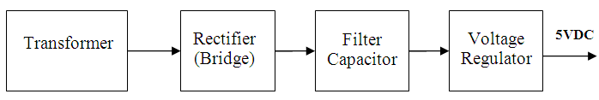
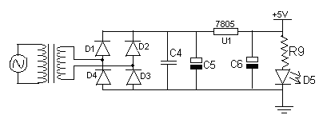
Power Supply Module
Power supply gives +5v supply to the circuit. It consists of four stages namely transformer, rectifier, filter, and regulator.

Slide 8
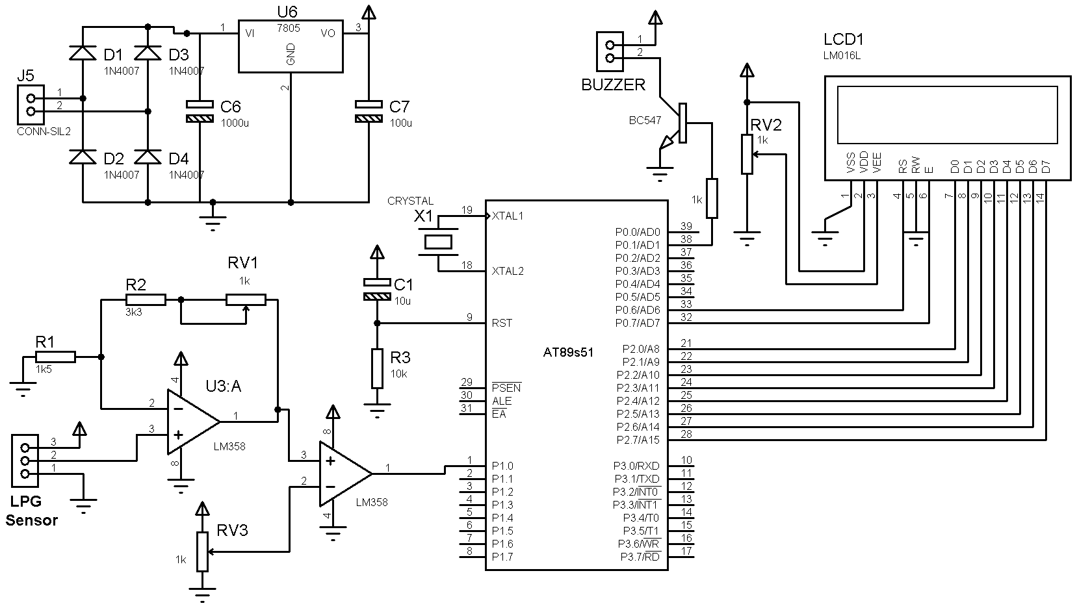
CIRCUIT DIAGRAM

Slide 9
Software used in our Project
EAGLE Software: It is used for PCB design, it includes Schematic Capture, Board Layout and Autorouter.
EAGLE has following 2 sections:
1) Schematic capture: For designing circuit diagrams. Parts can be placed on many sheets and connected together through ports.
2) PCB layout: It allows auto-routing to automatically connect traces based on the connections defined in the schematic.
KEIL software: It used for Microcontroller Programming Software. It has compiler designed specifically for the 8051 microcontroller. It converts a High Level Language source code (written in assembly language or C language) into its object code. Then a linker is used to create an absolute object module suitable for your circuit.

Slide 10
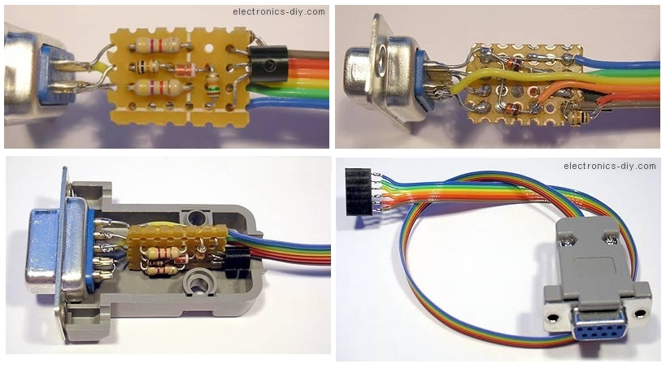
Microcontroller Programmer
It transfers hex programs to Microcontroller. It has in-circuit serial programmer & small PCB. You can connect it to microcontroller and program it. Programmer software shows progress status bar.

Slide 11
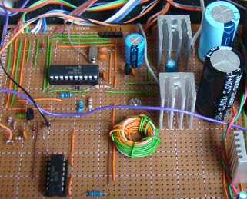
PCB Layout
A printed circuit board, or PCB, is used to mechanically support and electrically connect electronic components using conductive pathways, tracks or traces etched from copper sheets laminated onto a non-conductive substrate.
A good PCB design ensures that the noise introduced as a result of component placement and track layout is held within limits while still providing components years of assembly maintenance and performance reliability.
Printed circuits boards are used to route electric signals through copper track which are firmly bonded to an insulating base.

Slide 12
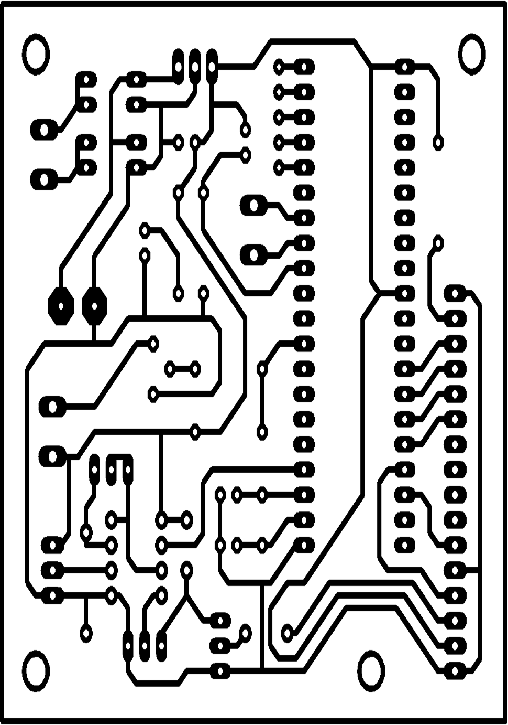
PCB layout of our project

Slide 13
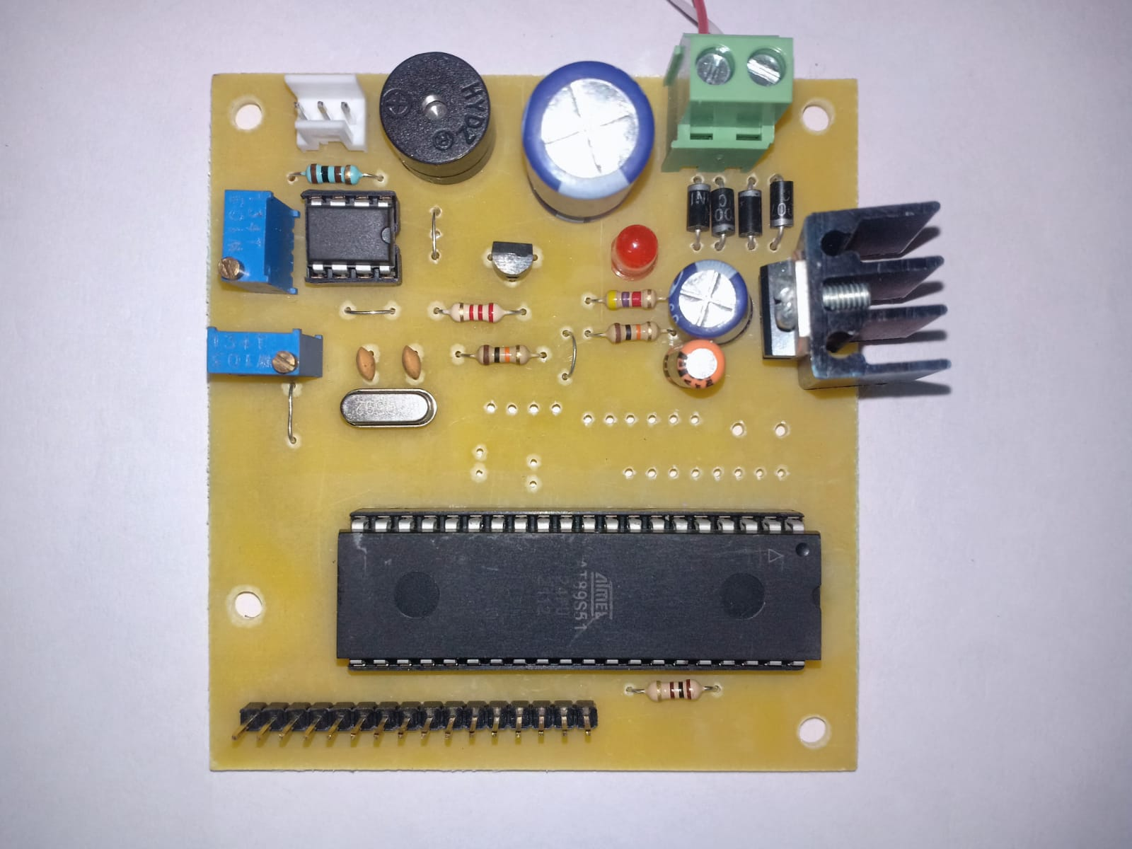
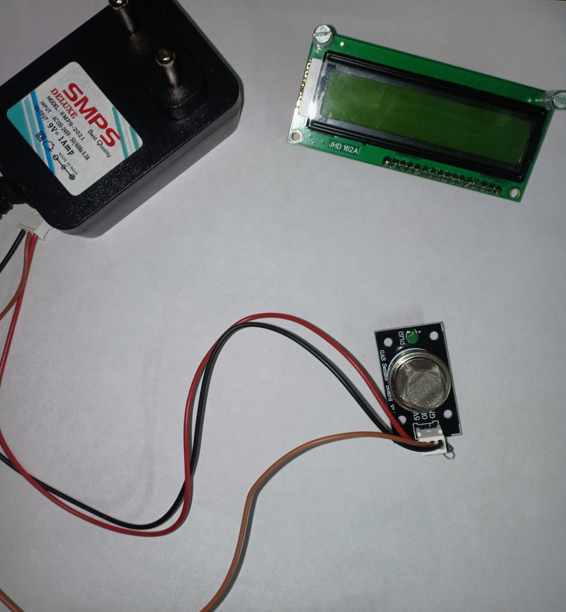
70% completion of our project

Slide 14
Conclusion
With the knowledge of new techniques in ‘Electronics’ we are able to make our life more comfortable. One such application of electronics is used in “LPG leakage detector with buzzer indication using Microcontroller”
We conclude that the various parameters play a great role. Here in this project we have successfully monitored and controlled parameters through various sensors and output devices.
We feel that our project serves something good to this world and we like to present it before this prosperous world.

Slide 15
Thank you

